Slide 1


Alert Eye – Object Detection System with Adaptive Voice Alerts
PUNE DISTRICT EDUCATION ASSOCIATION'S COLLEGE OF ENGINEERING Manjari (BK), Pune - 412307 (Maharashtra) India **NAAC Accredited**
Team Members : Naina Singh ( B400260)
Dipak Sirsath (B400260)
Samruddhi Lomate (B400260)
Prathmesh Udar (B400260207)
Group Id : PDEA-COEM-Comp-38
Project Guide : Prof. S. K. Chougule
Class : BE Computer Engineering

Slide 2
CONTENTS
Introduction
Problem Statement
Motivation,
Aim & Objectives
Literature Review /survey
Existing System
GAP Analysis & Challenges
Proposed System
Methodology
Project Planning (Time & Cost Estimation)
Requirement Analysis & SRS
12. System Architecture/Design
13. Structural & Behavioral Diagrams
14. Challenges & Risk Management
15. Results & Comparative Analysis
16. Testing & Validation
17. Research Publication
18. Awards & Participation
19. Future Work (Phase II)
20. Conclusion
21. References 22. Q&A / Thank You

Slide 3
Abstract :-
Overview of Project Domain: Creation of a system with integration of AI, IOT and Assistive Technology named Alert Eye.
Problem Background: Visually impaired individuals face difficulty in safe, independent navigation. Traditional aids (sticks, guide dog) lack object recognition and direction information. Existing smart devices are costly. Need for an affordable ,intelligent assistive system for real time awareness.
Importance and Relevance: Promotes independent mobility and safety for blind users. Combines AI vision + voice feedback for accessibility.
A step towards “Technology for Social Good” and inclusion Innovation.

Slide 4
Problem Statement
Definition of the Problem: Visually impaired individuals face immense challenges in perceiving their surroundings and avoiding obstacles while moving independently. Traditional aids provide limited spatial awareness and cannot recognize or describe nearby objects.
The proposed system aims to design and develop an AI-powered assistive system using Raspberry Pi, YOLOv11, ultrasonic sensors, and GPS technology for real-time object detection, location tracking, navigation assistance, and adaptive voice alerts.

Slide 5
Motivation
Millions of visually impaired people struggle with independent mobility. Traditional aids like sticks and guide dogs provide limited environmental awareness and no object recognition.
AI and IoT technologies make it possible to build affordable smart assistive systems. The proposed system uses YOLOv11, Raspberry Pi, ultrasonic sensors, and GPS technology for real-time object detection, navigation assistance, location tracking, and adaptive voice alerts, helping users move safely and confidently.

Slide 6
Aim and Objective
Aim (Goal): Develop an AI-powered assistive system using Raspberry Pi, YOLOv11, ultrasonic sensors, and GPS technology for visually impaired individuals.
Major Objectives:
Implement real-time object detection, distance estimation, and direction identification using YOLOv11 and sensors.
Generate adaptive voice feedback indicating object type, distance, and direction.
Provide GPS-based location tracking and navigation assistance for safer mobility.

Slide 7
Literature Review
Paper | Author(s) | Year | Research Highlights | Attributes | Tech Stack / Algorithms Used | Gaps Identified
YOLO-Based Object Recognition System for visually impaired | Akshaya M. George Aswathy Ramachandran | 2025 | A YOLOv3-based object recognition system achieved high accuracy and demonstrated superior real-time performance on a Raspberry Pi setup | average accuracy rate of 98%, 4-6 frames per second | YOLO v3 Algorithm , Text-to-speech conversion method , Raspberry Pi (3 Model b) , OpenCV , COCO dataset | not completely satisfactory, criticized for containing certain flaws
Real-time efficiency of YOLOv5 and YOLOv8 | Ali Hassan Sodhro , Sathwik Kannam,Michel Jensen | 2025 | Comparative analysis of YOLOv5 and YOLOv8 real-time confidence in human intrusion detection across diverse environments. | Higher confidence scores, models perform better outdoors | YOLOv5, YOLOv8 (yolov8n.pt) , IP camera, Jetson Nano , TSL2591 luminance sensor , OpenCV , Flask server. | neglecting real-time performance and the impact of environmental factors
ThirdEye | KoppalaGuravaiah | 2023 | "Third Eye" used YOLOv5 for object detection and gTTS/pyttsx3 for speech generation to assist the visually impaired | aid navigation provide environmental awareness, warning mechanism on object proximity. | YOLOv3 ,CNNs , Text-to-speech (TTS) technology , SSD COCO DATASETS , Python , MySQL Database , Apache Tomcat. | limited number of objects in the dataset or focusing only on indoor navigation

Slide 8
Paper | Author(s) | Year | Research Highlights | Attributes | Tech Stack / Algorithms Used | Gaps Identified
OBJECT DETECTION AND ALERT SYSTEM FOR VISUALLY IMPAIRED PEOPLE | Mr. P. Sudhakar | 2023 | Implementation of YOLOv3 for real-time object identification and a voice alert system to aid navigation for the visually impaired. | average accuracy rate of 98%, 4-6 frames per second | YOLOv3 (You Only Look Once version 3) algorithm , Computer Vision technologies , Text to Speech conversion technique | Expensive IoT devices, data over-burden
Text to speech converter | Frank Seide et al. | 2024 | Real-time speech transcription using token-streaming LLM. | Streaming ASR, low-latency | Real-time Whisper, KV Cache, DeepSpeed-Inference | No AI reply or personalization
BERT-ERC | Y. Qin et al. | 2023 | Emotion recognition in multi-turn dialogue using transformers. | Emotion detection, speaker-aware | BERT, DialogueRNN, Transformer | Only text-based, no video/audio

Slide 9
Existing System
High cost – devices like OrCam or Ally Solos are expensive.
Internet dependency – limited offline functionality.
Detect faces, text, and objects using AI.
Use cloud processing for recognition tasks.
Provide basic navigation guidance through GPS.
Require cloud connectivity for data storage.
Subscription fees are needed for full access to features.

Slide 10
Gap Analysis and Challenges
Existing System:
OrCam My Eye – Smart wearable camera that reads text, recognizes
faces & objects..
Limitations/Gaps in Existing Systems (Commercial and Research):
High cost – unaffordable for most users.
Limited object detection accuracy in complex or dark environments.
Requires constant internet or cloud connectivity.
Low battery life and heavy hardware.
No adaptive alerts for distance or direction.
No caregiver dashboard for monitoring user safety
Real-time processing on limited Raspberry Pi resources.
Alert Eye Improvement (Gap Filling):
Affordable solution using Raspberry Pi and open-source AI models.
Real-time object detection with YOLOv11 on edge device (offline capable).
Distance & direction estimation using ultrasonic sensors
Adaptive voice alerts for contextual awareness.
GPS-based navigation and live location tracking for safer mobility.

Slide 11
Proposed System
Overview : AI-based real-time object detection system
Provides voice alerts, distance estimation, direction detection, and GPS navigation assistance for visually impaired users
System Architecture / Block Diagram: (The following is the high-level flow)
User Input: Start Detection Command
Camera captures real-time surroundings
YOLOv11 detects objects from live feed.
Ultrasonic sensor measures distance.
System identifies object direction
GPS provides location tracking/navigation
Speaker gives adaptive voice alerts.

Slide 12
Methodology
Tools, Technologies, and Algorithms:
Model/ Voice processing : YOLOv11 ,pyttsx3.
Hardware : Raspberry Pi 5 , Microphone , Camera , Ultrasonic Sensors , GPS Module
Core Logic:
Object Capture: Capture image/video frames .
Object Detection: Detect using YOLOv11 model.
Voice Alerts: pyttsx3 , direction and distance estimation.
GPS Navigation: Provide location tracking and navigation assistance
Major Phases (Workflow):
Phase 1: Hardware setup and sensor calibration
Phase 2: Model training and real-time detection setup
Phase 3: Integration of distance, direction, and GPS modules
Phase 4: Voice alert generation and optimization
Phase 5: Testing and deployment
Phase 6: Performance tuning

Slide 13
Project Planning
Phase | Timeframe | Focus | Key Activities & Deliverables
Phase 0: Inception & Discovery | July - Sept | Project Foundation | Ideation, Team Formation, Initial Research, Requirements Gathering (High-Level), Technology Vetting, and Project Charter Finalization. Deliverable: Approved Project Charter & Initial Roadmap.
Phase 1: Planning & Setup | Mid-Sept - Oct | Technical Blueprint | Detailed Requirements & Budget Planning, Tech Stack Finalization, and Architecture Design. Deliverable: Technical Design Document & Project Foundation Ready.
Phase 2: Core Interaction | Late Oct - Dec | Core Functionality | Model Integration (YOLOv11), TTS/STT Integration, Real-time object capture Flow, Memory Storage, and Context Retrieval. Deliverable: Functional Core system (MVP).
Phase 3: Detection and alerts | Dec - Jan | Personalization & UX | Object identification, Object detection and voice alerts Integration, Deliverable: Interactive, Assistive AI Object Detection and Adaptive alert prototype.
Phase 4: Real-Time UX & Deployment | Jan - Feb | Launch Readiness | Feature Prioritization (based on beta feedback), Continuous Integration/Continuous Deployment (CI/CD) scaling Webcam object Detection , and Final Testing & Documentation. Deliverable: Public Beta Ready & Final Documentation.
Phase 5: Enhancements & Go-Live | Mar - Apr | Scaling & Handover | Formal Production Go-Live, and Project Handover. Deliverable: Full Production System & Project Closure.

Slide 14
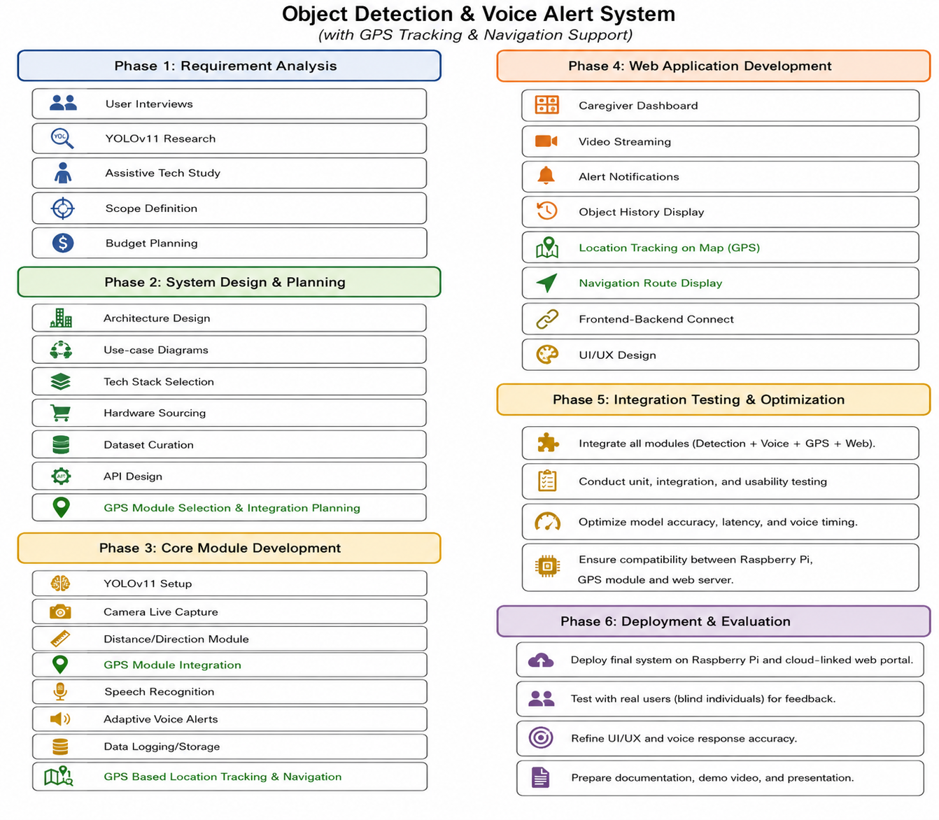
Project Flow :

Slide 15
Task Distribution (Work Breakdown Structure):
Hardware : Raspberry Pi , mic/speaker , camera , GPS Module
Backend: pyttsx3, YOLOv11 model,
memory
Object detection and adaptive voice alert: detection, voice alerts
Deployment: hosting, security, testing
Cost Estimation (Formula: Total Cost = Hosting + APIs + Storage/Misc+Hardware):
Raspberry Pi: ₹6500
Ultrasonic Sensors: ₹300
GPS Module: ₹800
Storage/Misc: ₹500 (one-time/monthly approx.)
Camera: ₹500

Slide 16
Requirement Analysis
Functional Requirements:
Object Detection & Classification – Real-time detection using YOLOv11.
Distance Estimation – Using Ultrasonic sensors for measuring proximity.
Direction Identification – Determines left, right, or center position of objects.
Voice Alert Generation – Adaptive speech output using gTTS / pyttsx3.
Emergency Alert Feature
GPS Navigation: Provides location tracking and navigation assistance
Non-Functional Requirements:
Performance: Detection and voice latency < 2 seconds.
Scalability: System must be deployable and expandable for multiple users.
Reliability: Target 99% uptime for continuous assistive operation.
Usability : Simple and accessible voice-based feedback for end users.
Maintainability: Modular code for easy updates and debugging.
Portability: Lightweight and compatible with Raspberry Pi hardware.

Slide 17
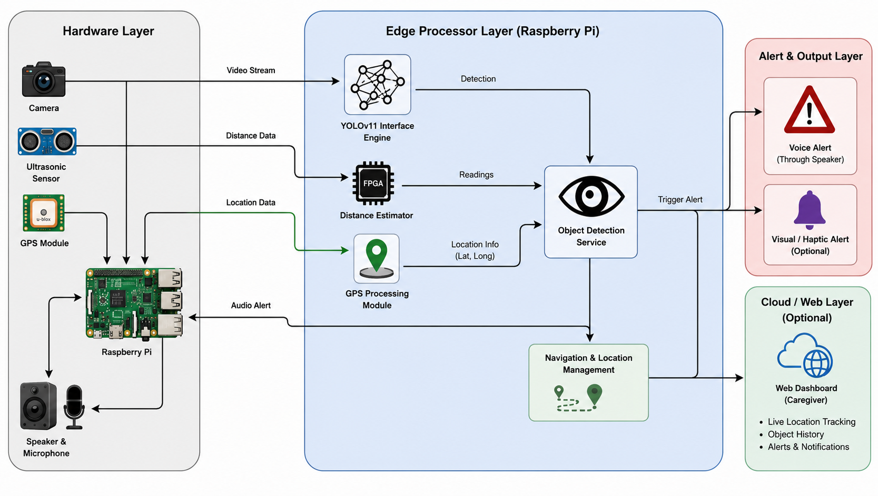
System Architecture Diagram :

Slide 18
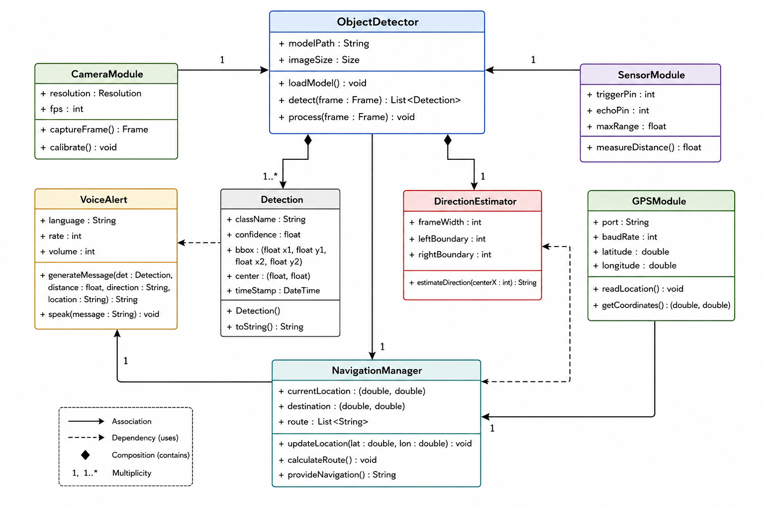
Structural Diagram : Class Diagram

Slide 19
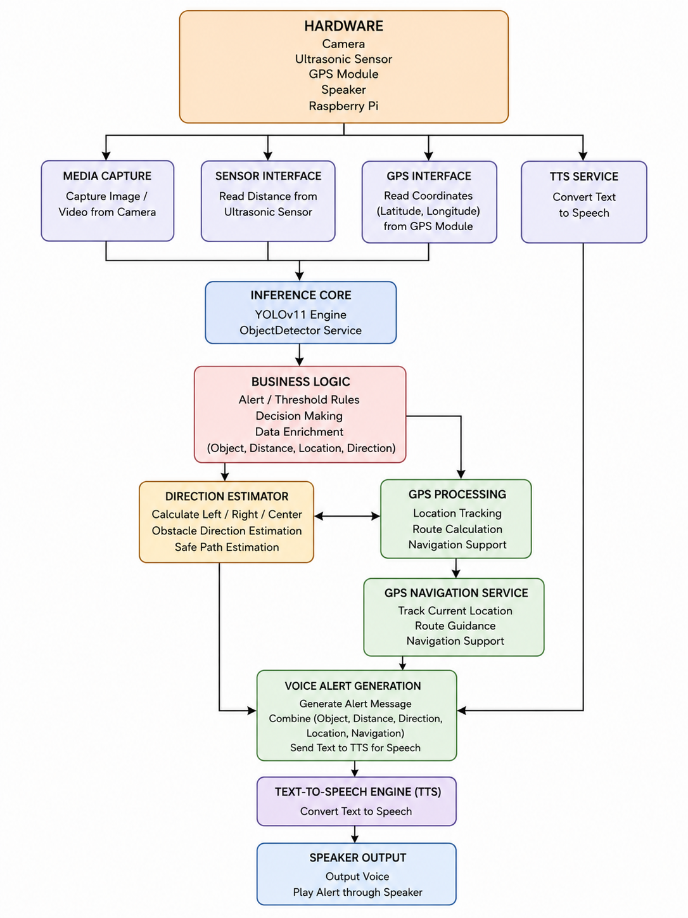
Component Diagram

Slide 20
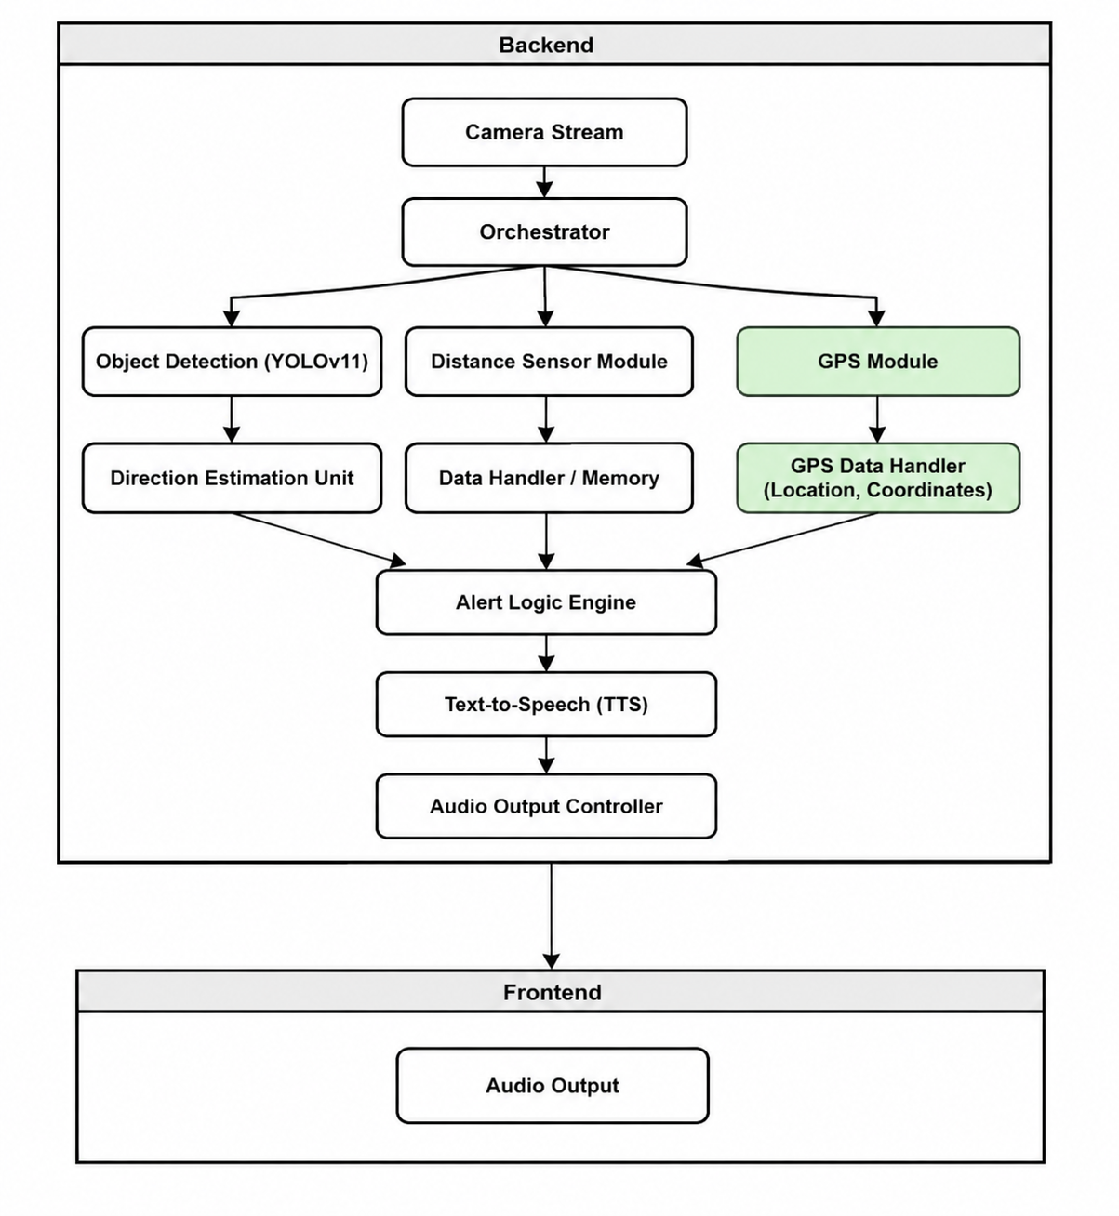
Composite Structure Diagram

Slide 21
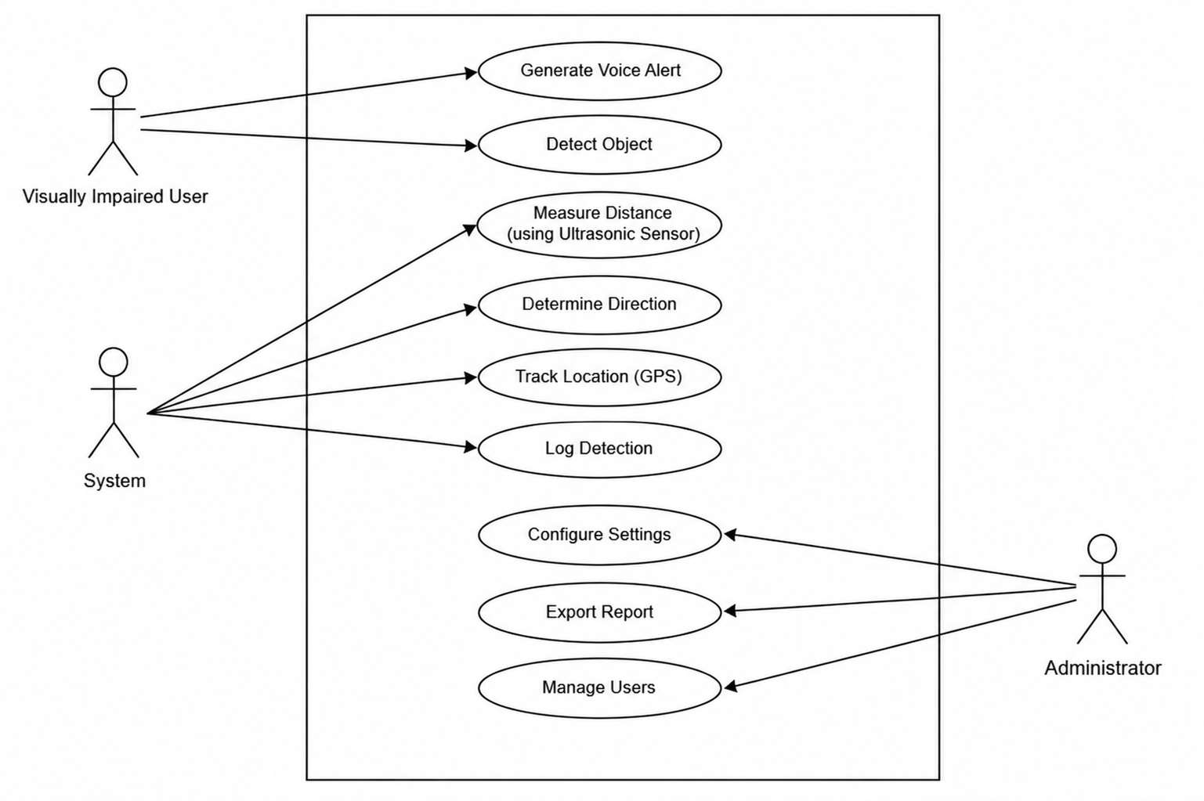
Behavioural Diagram :

Slide 22
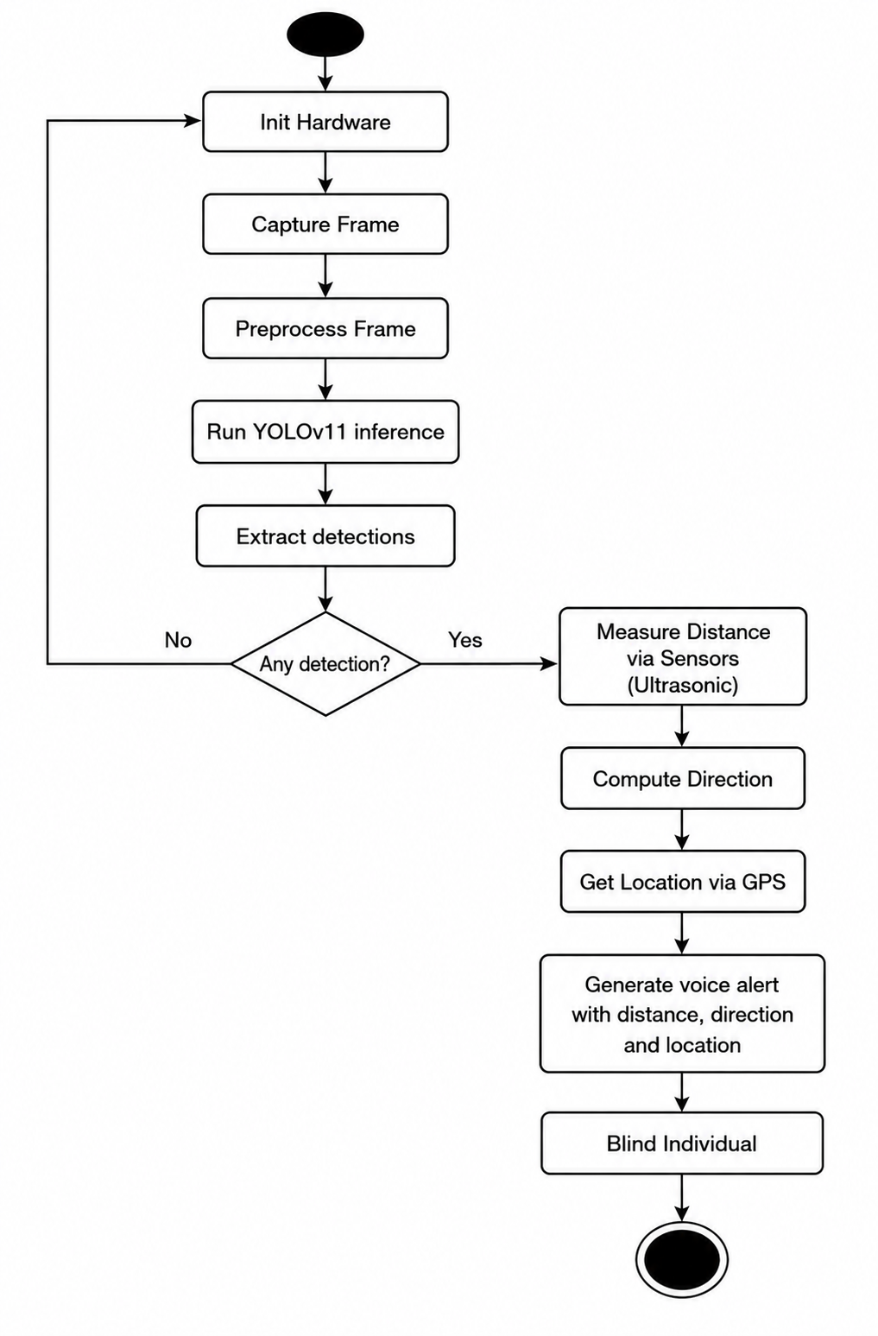
Activity Diagram

Slide 23
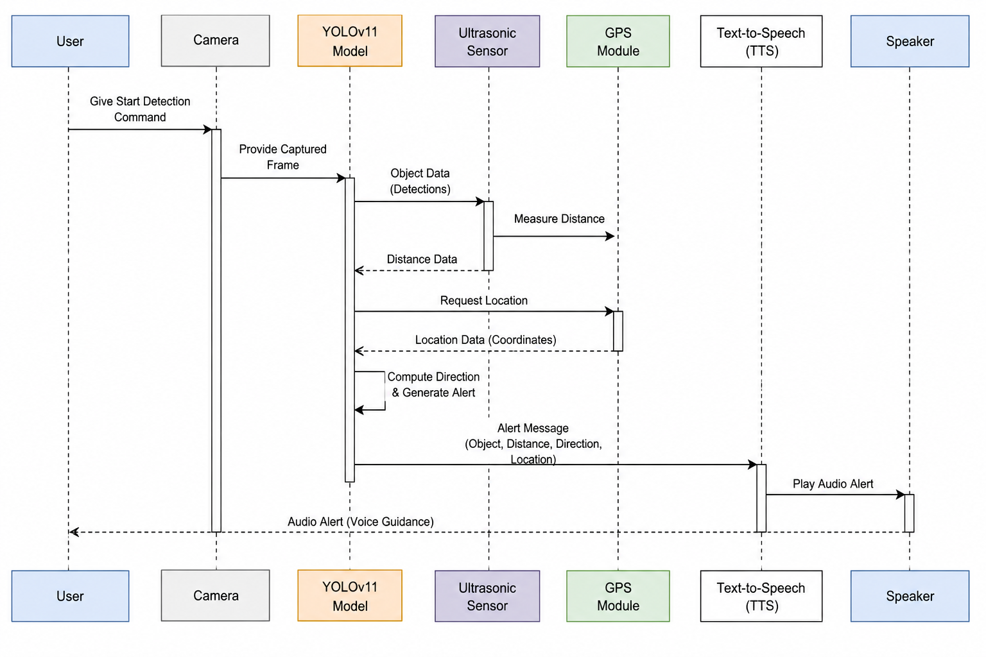
Sequence Diagram

Slide 24
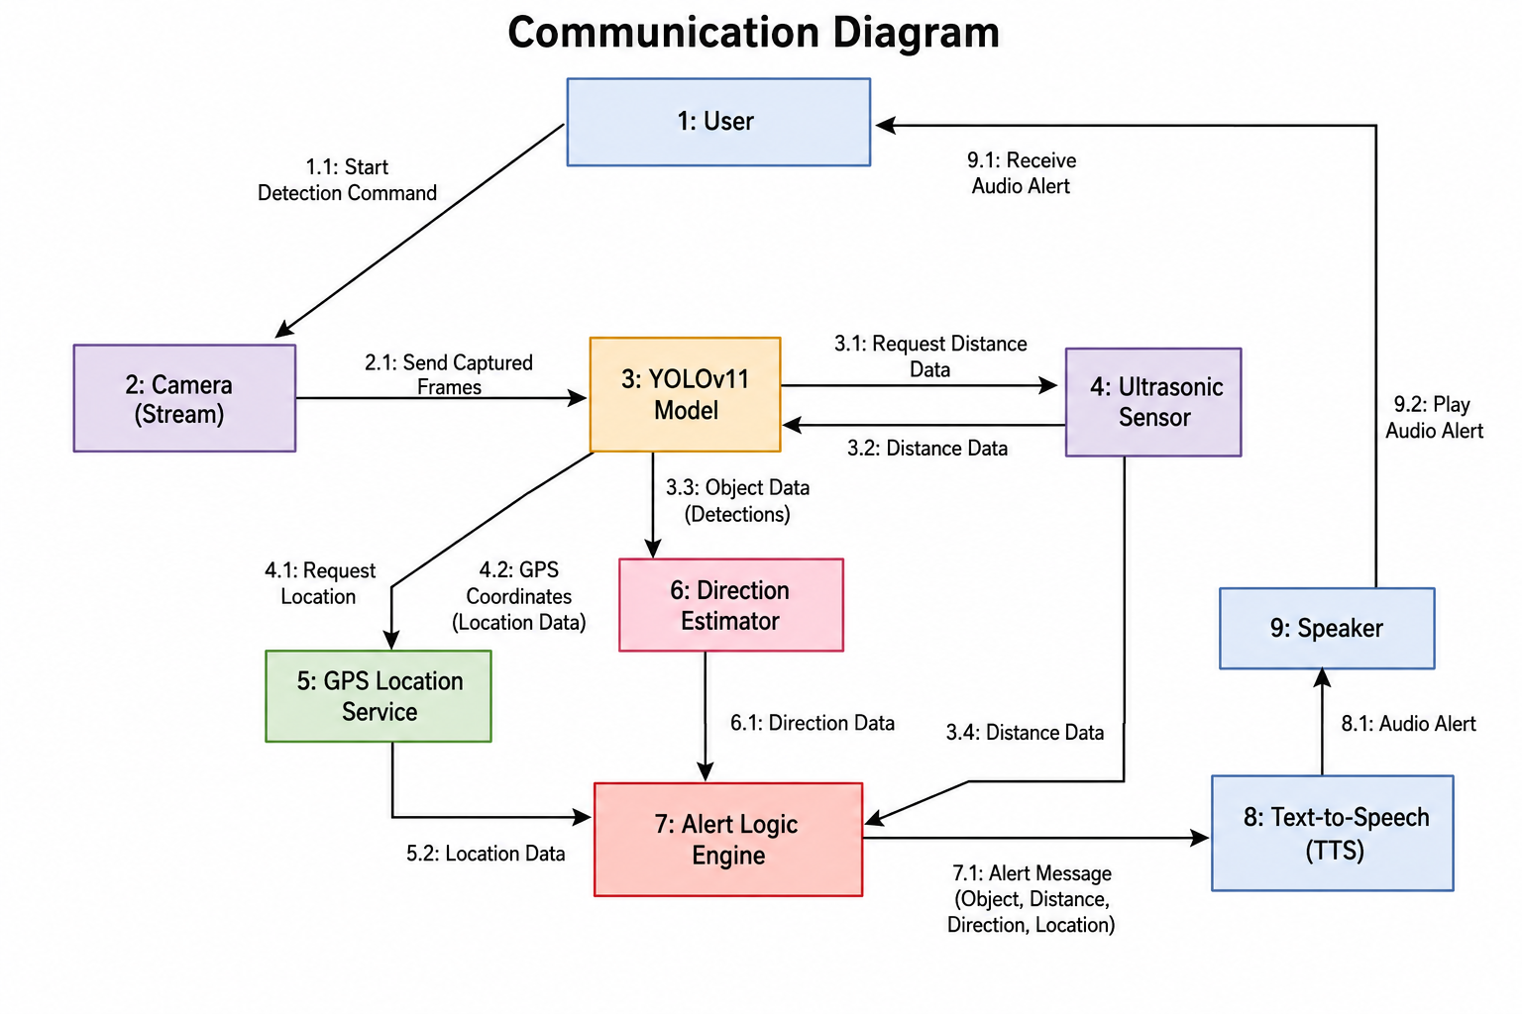
Communication Diagram

Slide 25
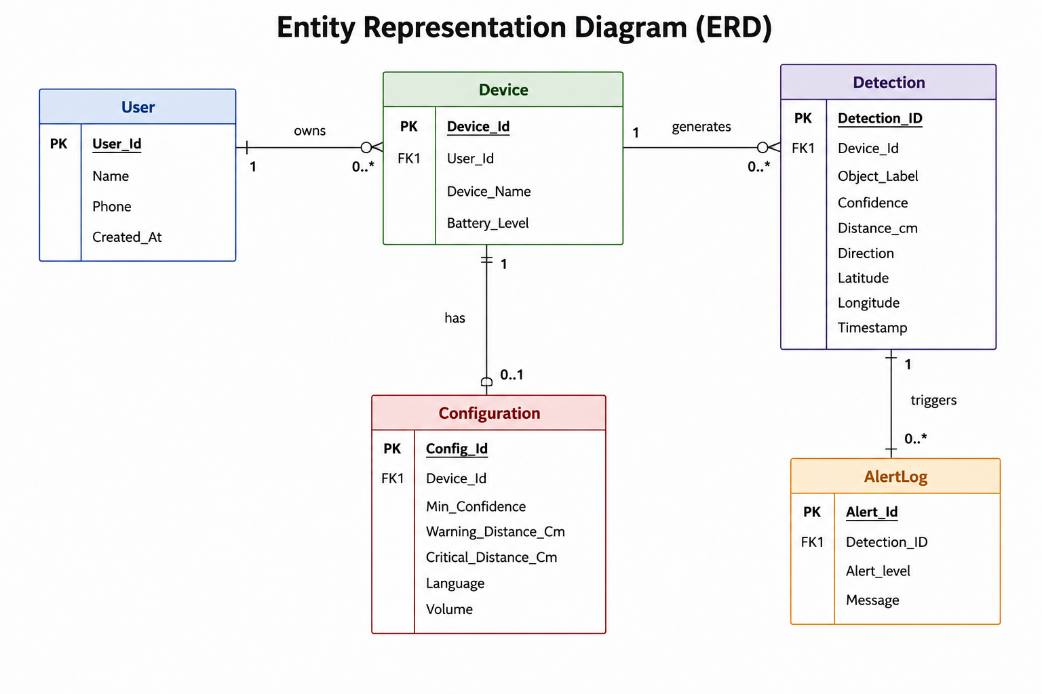
Entity Representation Diagram

Slide 26
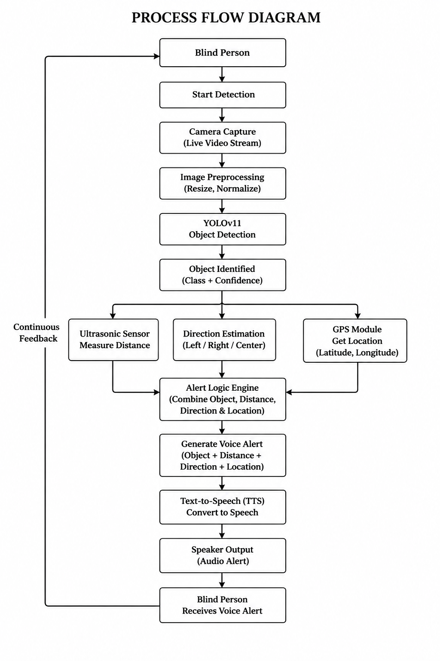
Process Flow Diagram

Slide 27
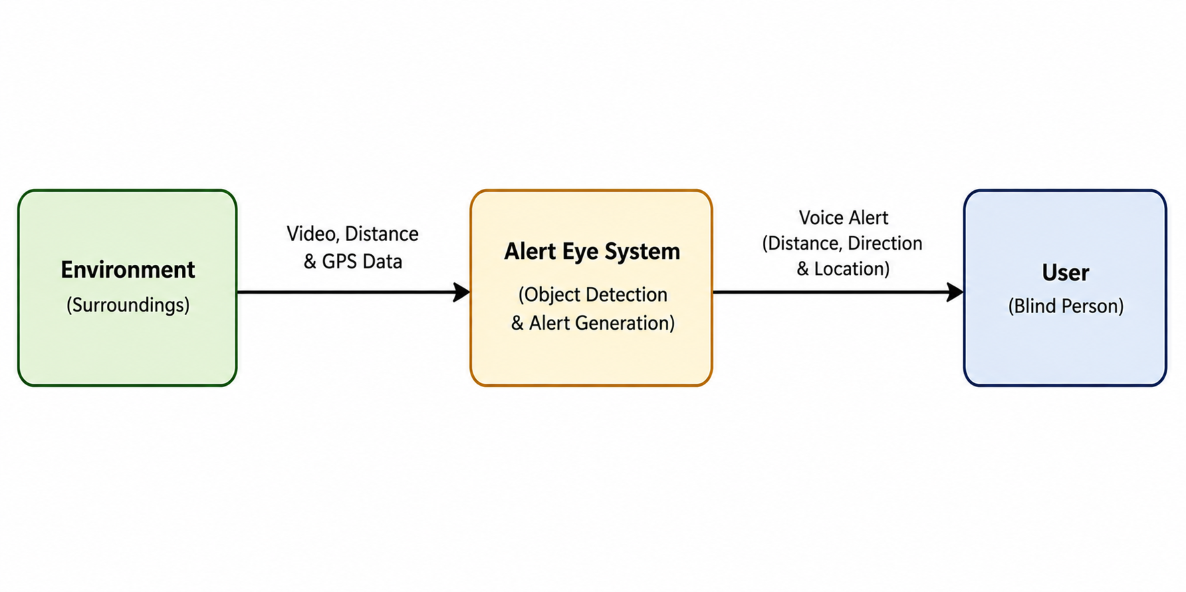
Data Flow Diagram Level 0 :

Slide 28
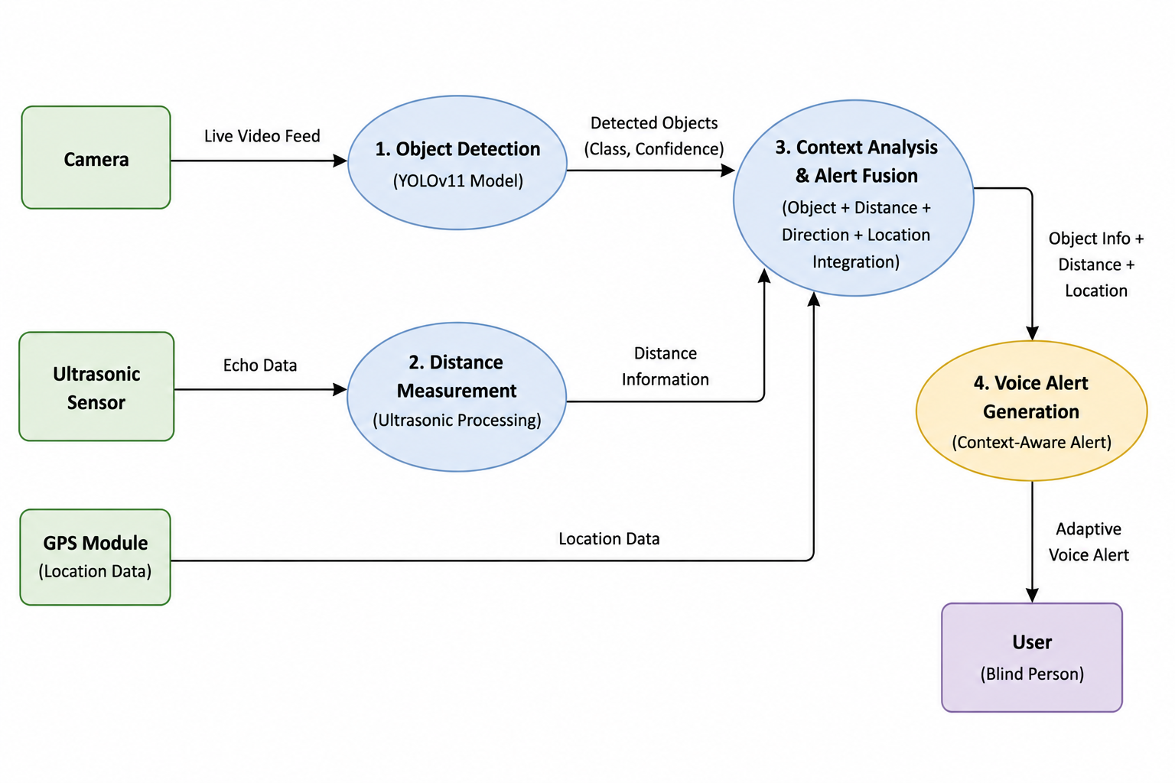
Level 1

Slide 29
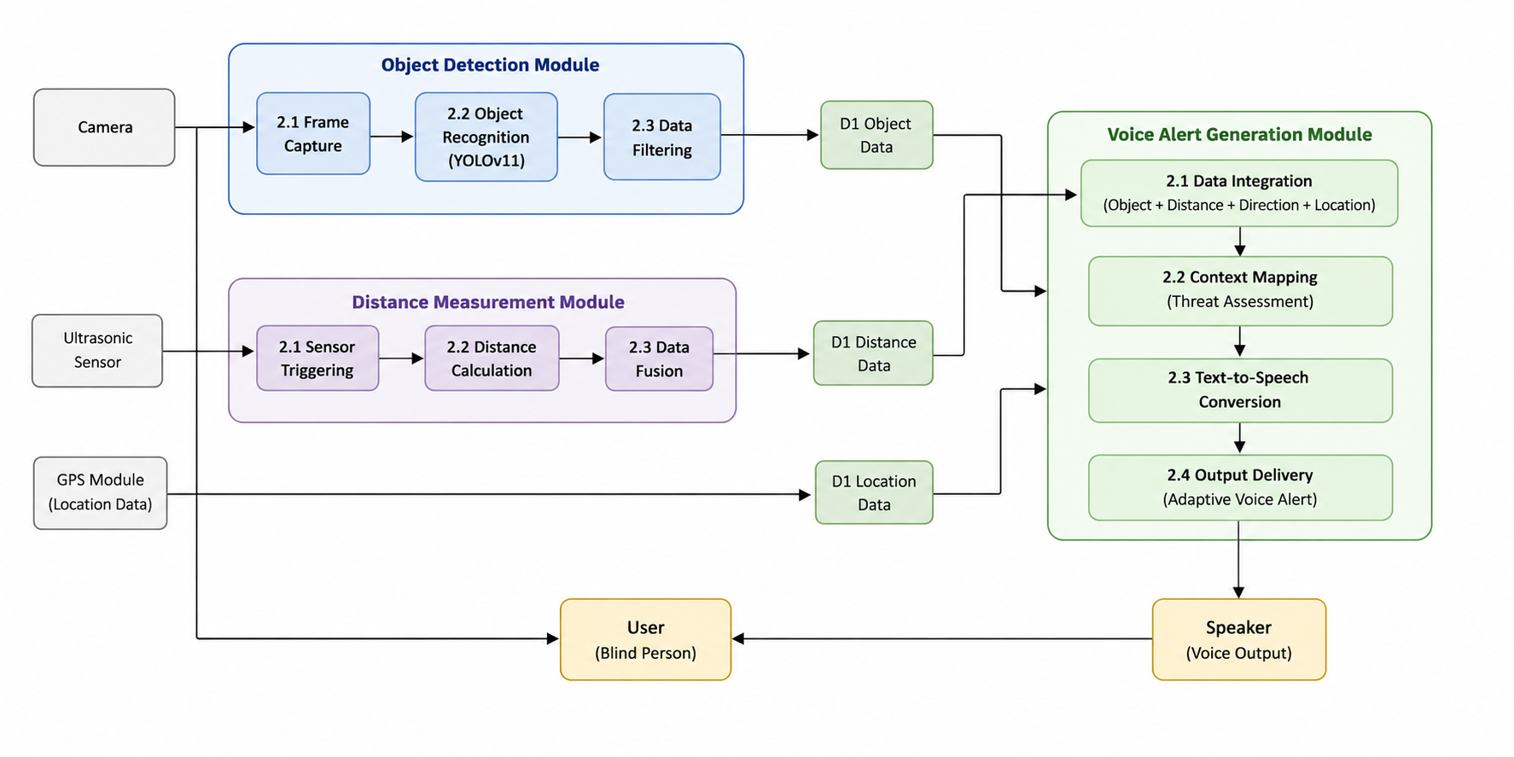
Level 2

Slide 30
Challenges & Risk Management
Technical Challenges Faced (Inferred):
Real-time object detection speed optimization
Integration of voice command and audio feedback
Managing camera input latency
Model accuracy under low-light or noisy conditions
GPS signal accuracy and connectivity issues
Risk Factors Identified (Inferred):
Hardware failure or camera disconnection
Data loss or corrupted video feed
Model misclassification affecting user safety
Network or API downtime.
GPS signal loss or inaccurate location tracking
Mitigation Strategies:
Use lightweight YOLOv11 model and GPU acceleration
Implement error-handling and auto-reconnect logic
Maintain regular model retraining and validation
Enable local backup and offline processing mode.
Use offline GPS caching and fallback navigation support

Slide 31
Future Work (Phase II)
Deployment and testing on a Raspberry Pi-like embedded device using an off-the-shelf camera module and GPS integration.
Focus on detecting a predefined set of common objects and obstacles, such as people, vehicles, furniture, and common environmental hazards.
Implementation of real-time auditory feedback for objects detected within a specified distance range from the user, along with GPS-based navigation assistance.
Initial testing in both controlled indoor environments and varying outdoor settings to validate adaptability, navigation support, and overall system performance.

Slide 32
Results & Outcomes:-

Slide 33
Comparison with Existing Systems
Feature | Existing Systems | Alert Eye
Cost | High | Low
Offline Support | Limited | Yes
Object Detection | Yes | Yes
Distance Estimation | No | Yes
Direction Detection | No | Yes
GPS Tracking | Limited | Yes
Adaptive Voice Alerts | Basic | Advanced

Slide 34
Testing of Hardware and Software Components
Hardware Testing
Camera module tested
Ultrasonic sensor tested
GPS module tested
Speaker/Microphone tested
Software Testing
YOLOv11 detection accuracy
Voice alert generation
Distance calculation
GPS location retrieva

Slide 35
Research Publication

Slide 36
Awards & Participation

Slide 37
Conclusion
The system provides real-time object detection, GPS-based navigation, and voice alerts to assist visually impaired users
Combines YOLOv11, AI, Raspberry Pi, and GPS technology for smart assistance.
Promotes independence, safety, and accessibility through affordable technology.
Demonstrates the social impact of AI and IoT in improving everyday mobility.

Slide 38
References
W. Wang et al., “YOLO-OD: Obstacle Detection for Visually Impaired Navigation,” Sensors, vol. 24, no. 23, 2024.
R. Litoriya et al., “Visual Assistant Using YOLO and SSD,” J. Autom. Mobile Robotics, vol. 17, no. 4, 2023.
S. Mallikarjun et al., “YOLOv8n-Based Lightweight Object Detection,” Utilitas Mathematica, vol. 122, 2025.
J. Li et al., “PC-CS-YOLO: Obstacle Detection for Visually Impaired,” Sensors, vol. 25, no. 2, 2025.
V. S. Saranya et al., “IoT-ML Approach for Visually Impaired Assistance,” IJISAE, vol. 12, no. 6s, 2023

Slide 39
QNA
Thank You

